Slide 1
Additional Practice Problems
1. Find the total heat energy to change the temperature of 250 g of water from room temperature of 150 C
2. Find the required energy for 100 gm gold from 20 C to completely melt. [melting point of gold is 1063C].
3. How much heat must be absorbed by ice of mass m= 720 gm at -10 C to take it to the liquid state at 15 C?

Slide 2
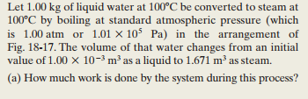

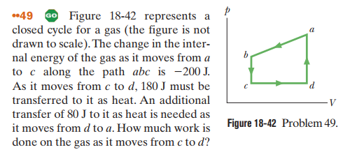
4. Sample Problem: 18.05
5.

Slide 3



Slide 4
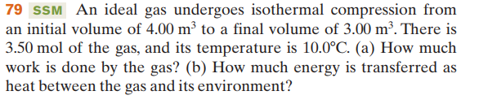
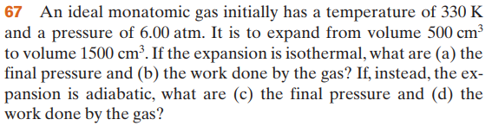

Slide 5

